Slide 1
UVM Verification of ALU Design
Submitted by:
Fagr Ahmed Abd Elrazek “AUC section 12” ID:V23010586
Marwa Moaz “AUC section 14” ID:V23009897
Mohamed Yasser “AUC section 16” ID:V23010495
shurooq Mohammad Hassan Alshal “AUC section 12” ID:V23010529
Submitted to:
Dr. Ahmed Saeed
Eng. Randa Aboudeif

Slide 2
Agenda
Introduction
Verification Environment
TLM
Scoreboard
Coverage and Randomization
Commands used

Slide 3
Introduction

Slide 4
Introduction
UVM verification of ALU design
ALU performs different arithmetic & logic operations in addition to NOP
THE UVM environment consists of 1 active agent agent and 1 environment class
The input carries and opcode are randomized
Code Coverage and functional coverage are collected
The scoreboard contains the reference model
Coverage percent is 100% and no errors are detected from the scoreboard

Slide 5
Verification environment

Slide 6
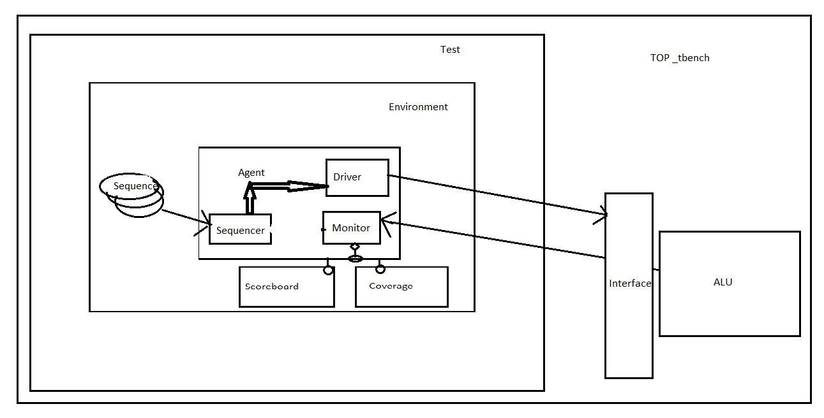
Environment

Slide 7
TLM

Slide 8
TLM
Analysis port at the Monitor
Analysis export at the agent
Analysis imp at the Scoreboard
Analysis imp at the Coverage
Connection in Environment

Slide 9
Scoreboard

Slide 10
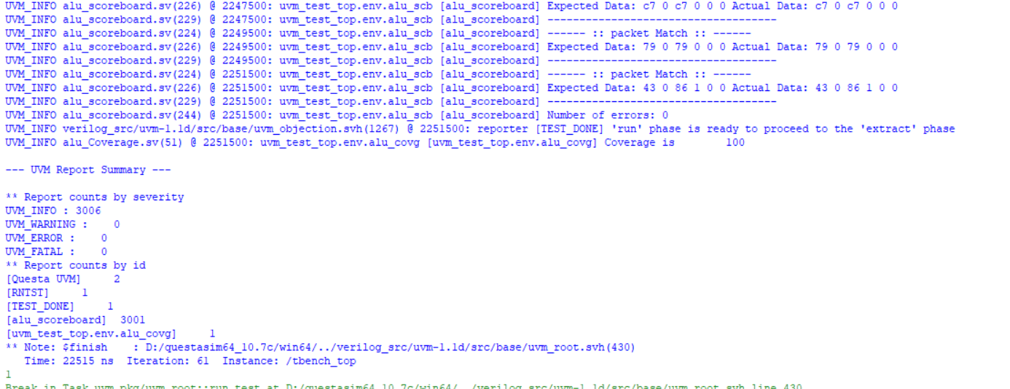
Scoreboard
Implements reference model to mimic the ALU performance
Compare the dut output with scoreboard output and evaluate the number of errors
No errors are present

Slide 11
Coverage and Randomization

Slide 12
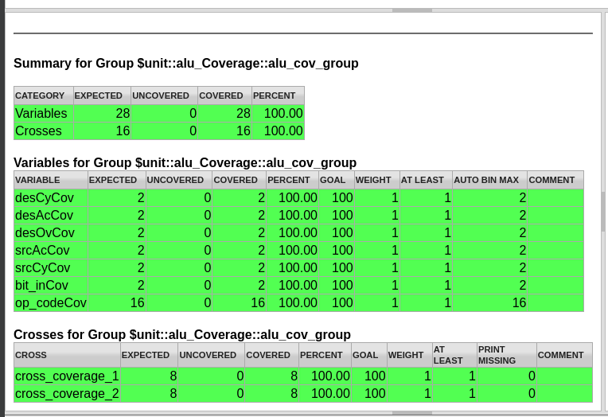
Coverage &Randomization
Randomize opcode and inout carries
Coverage on carries and opcode
Achieve 100% code and functional coverage

Slide 13
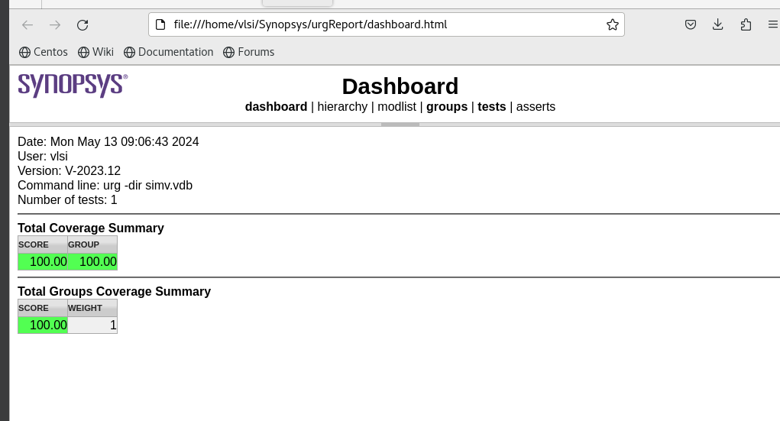

Slide 14
Commands used

Slide 15
Commands used
VCS:
Compilation
vcs – sverilog -ntb_opts uvm-1.2 testbench.sv
Simulation
./simv simv.log +UVM_TESTNAME=alu_base_test
Coverage
./simv -cm line+cond+fsm -cm_name testbench
urg -dir ./simv.vdb -format both

